Slide 1

Intune Managed App Badging System
Rachel Shephard, Valeria Donati, Olivia Dang, Kieran Phelan

Slide 2

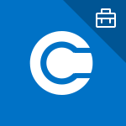
Intune Managed App Badging System
Guidelines for producing integrated “Badge” (icon overlay or corner banner) on icons and icon tiles to indicate your app is being managed with Intune.

Slide 3
Guidelines

Slide 4
Product icon badging for Intune managed applications
Depending on the platform and UI location you are working in you may need to create a free-standing icon and/or an icon placed within a background rectangle (tile).
Product logo Intune “managed” icon overlay
For use when delivering free-standing icons (no background “tile”)
Use the provided overlay icon in the assets folder <free-standing_overlay.ai or .eps>
Change the color background/outline on the managed overlay icon to a matching color on the product logo and place over your product icon at the lower right corner as shown in the examples. Briefcase icon color must remain white.
The overlay icon should be about 50% of the height of your icon.
Product icons on tiles
To create an icon on a tile, begin with one of the provided tile templates in the assets folder.
Scale your icon to fit approximately centered on the provided square shape. Icon should be about 50% of the size of the square.
Choose an appropriate fill color for the tile and the corner banner.
Suggested: use the corner banner with 25% opacity black to contrast your selected tile fill color.
Make sure the briefcase icon stays in the exact position on the corner banner as provided (in part to accommodate Mac/iOS rounded corners). Briefcase icon color must remain white.

Slide 5
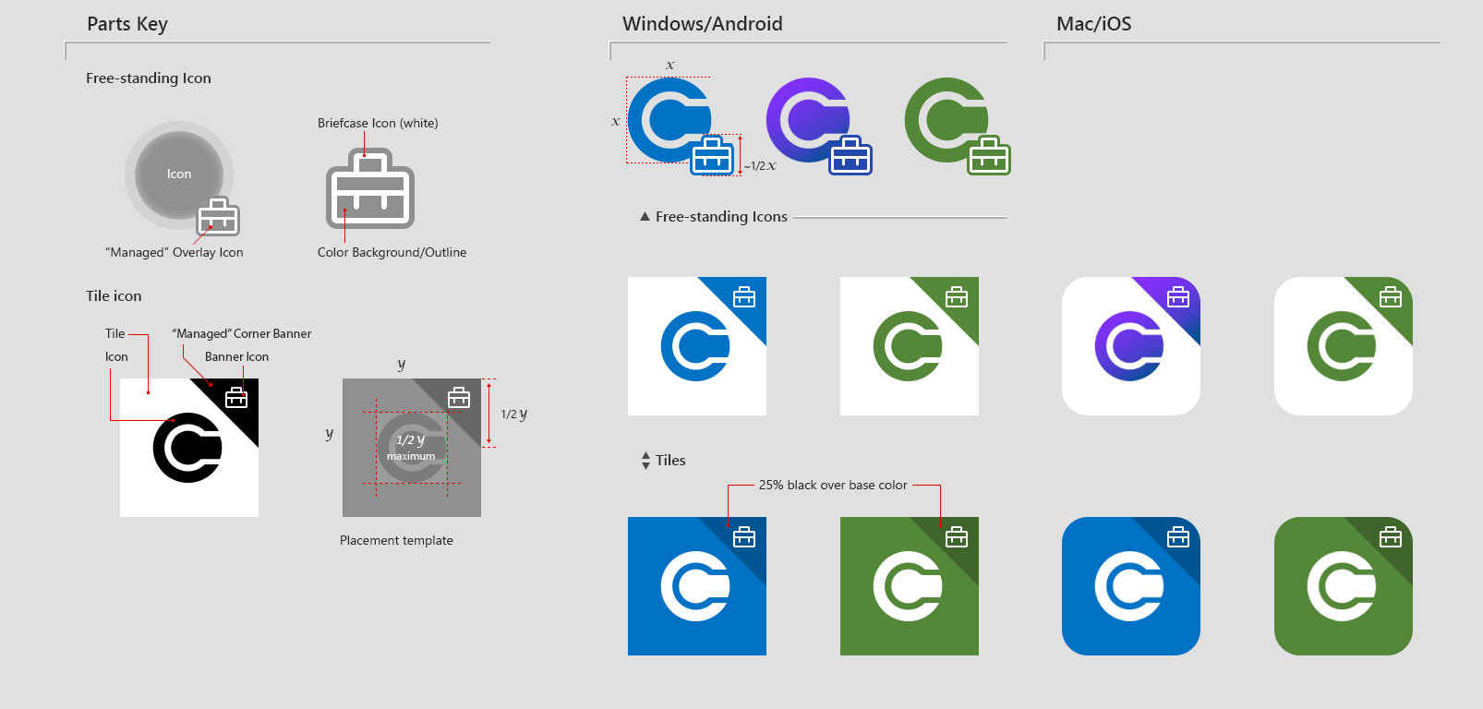
Parts and terminology

Slide 6
Device mock-ups

Slide 7
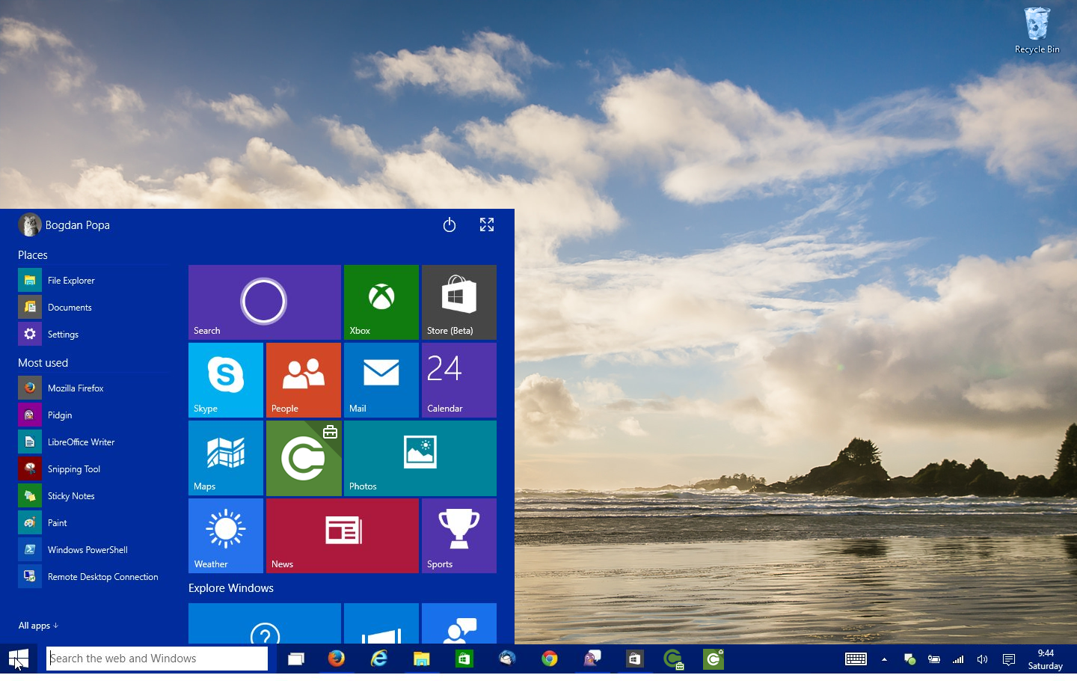
Windows Desktop

Slide 8
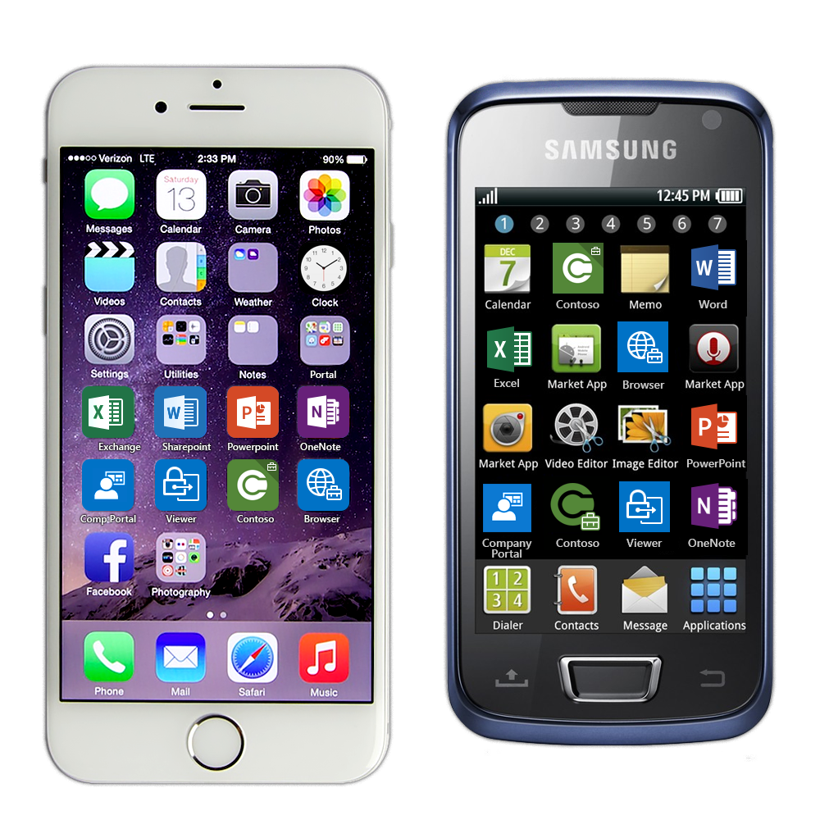
iPhone
Android

